Slide 2
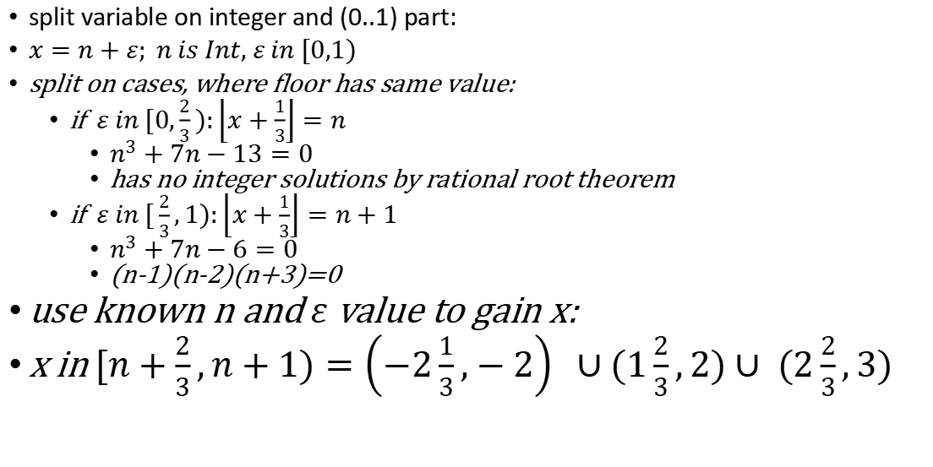

$${\left\lfloor x\right\rfloor }^{3}−7\left\lfloor x+\frac{1}{3}\right\rfloor =−13$$
split variable on integer and (0..1) part:
$x=n+ε; n is Int, ε in [0,1)$
split on cases, where floor has same value:
if $ε in [0,\frac{2}{3}):\left\lfloor x+\frac{1}{3}\right\rfloor =n$
$n^{3}+7n−13=0$
has no integer solutions by rational root theorem
if $ε in [\frac{2}{3},1):\left\lfloor x+\frac{1}{3}\right\rfloor =n+1$
$n^{3}+7n−6=0$
(n-1)(n-2)(n+3)=0
use known n and $ε$ value to gain x:
x in $[n+\frac{2}{3},n+1)=\left(−2\frac{1}{3},−2\right) ∪(1\frac{2}{3},2)∪ (2\frac{2}{3},3)$

Slide 3
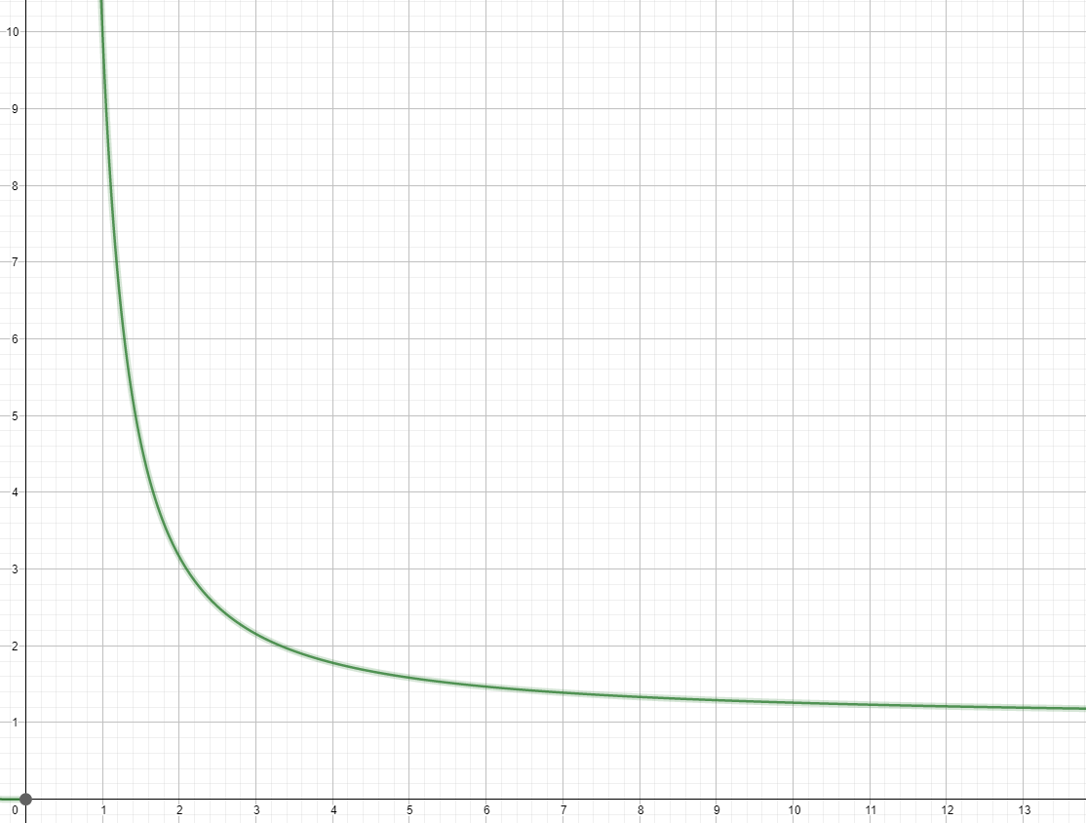

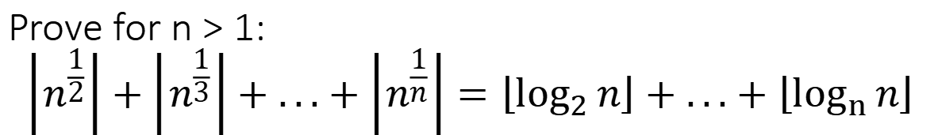
Prove for n > 1: $$\left\lfloor n^{\frac{1}{2}}\right\rfloor +\left\lfloor n^{\frac{1}{3}}\right\rfloor +...+\left\lfloor n^{\frac{1}{n}}\right\rfloor =\left\lfloor \log_{2}{n}\right\rfloor +...+\left\lfloor \log_{n}{n}\right\rfloor$$
y=$n^{\frac{1}{x}}:$ (for example n = 10)
x=$\log_{y}{n}$

